Slide 1
CS248 Lecture 2
Introduction to Unity
January 11th, 2017

Slide 2
Course Logistics
Piazza
Staff Email: cs248.staff@gmail.com
SCPD Grading via Google Hangouts
Homework 1 due Tuesday (January 16th)
If MLK day does not work for you, find a CA on January 17th.
Go to office hours OR schedule a time with another CA in advance.
Can not make the grading session? Get in touch with the CA’s.
Office hours on website. Any changes will be announced on Piazza.
Fill out the survey

Slide 3
Overview
Who Uses Unity?
Getting Setup with Unity
Unity Resources
Unity Overview
Unity Tutorial
Live Demo
Q&A

Slide 4

Who Uses Unity?
More than just poor indie developers

Slide 5

Who Uses Unity?

Slide 6

Who Uses Unity?

Slide 7

Who Uses Unity?

Slide 8

Who Uses Unity?

Slide 9

Who Uses Unity?

Slide 10

Who Uses Unity?

Slide 11
Who Uses Unity?
And more! https://en.wikipedia.org/wiki/List_of_Unity_games

Slide 12
Getting Setup with Unity
There really isn’t much to setup.

Slide 13
Installation
Download the ‘Personal Edition’: https://unity3d.com/get-unity
Select appropriate build targets during installation!
iOS: Come to my office hours to get added to the Stanford’s Apple Developer account
Wait for an announcement on Piazza. Currently some licensing problems that need to be resolved by Stanford’s legal department…may take awhile.

Slide 14
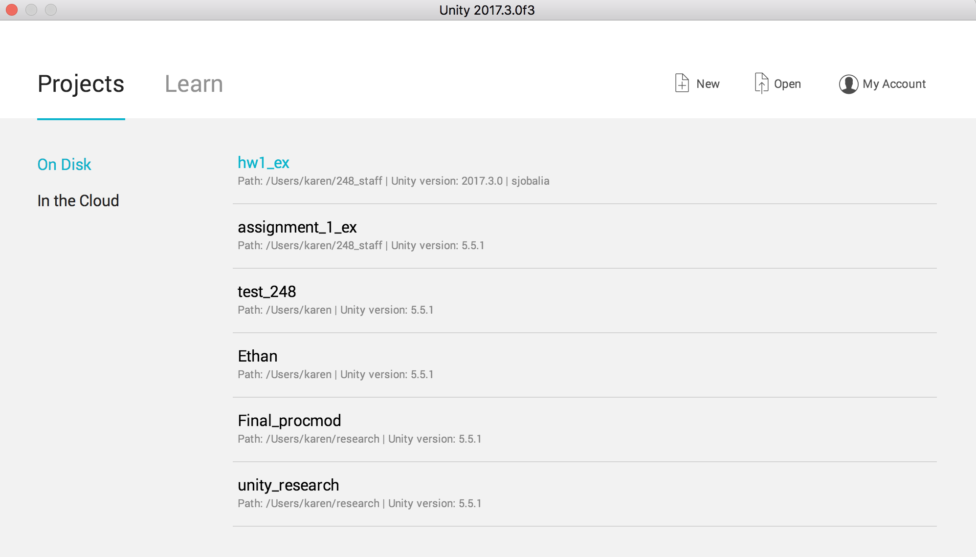
Project Creation

Slide 15
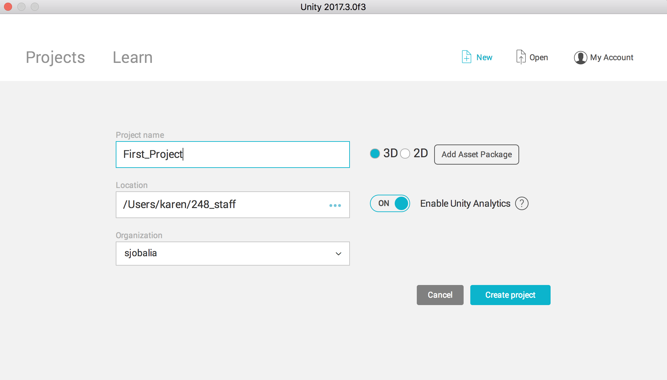
Project Creation

Slide 16
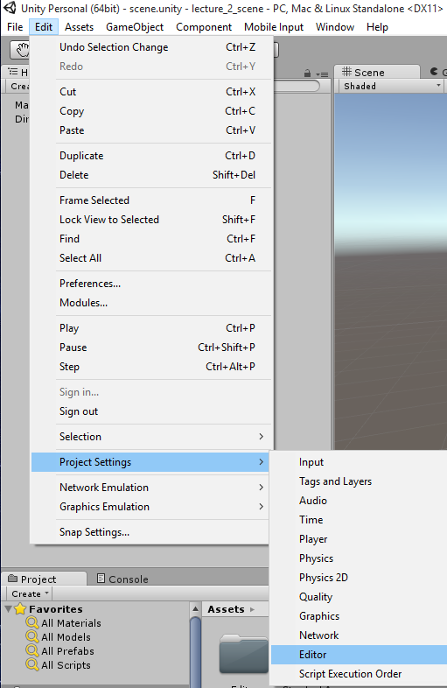
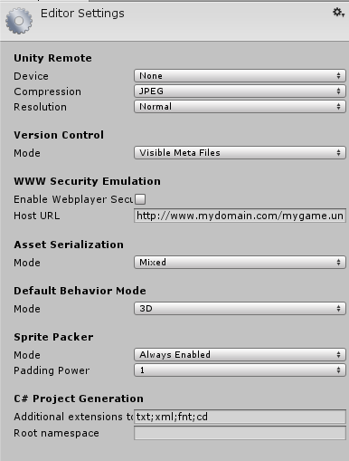
Source Control Setup (Git)
Note: If you do end up using source control (i.e. Github, Bitbucket), make your repository private.

Slide 17
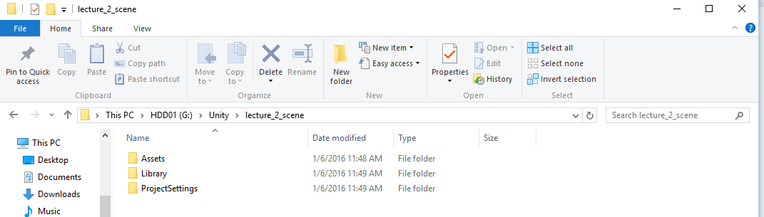
Source Control Setup (Git)
Assuming you have your repository setup (Github comes with a “.gitignore” for Unity, use it!
Go to where your project is located (from project setup screen: Location followed by the project name)
Delete the “Library” folder.
Point your command line git to the folder and run:
git init
git remote add origin GIT_URL_HERE
git pull origin master
git commit -am “COMMIT_MESSAGE”
git push origin master
Unity Docs: http://docs.unity3d.com/Manual/ExternalVersionControlSystemSupport.html
Smart Merge: http://docs.unity3d.com/Manual/SmartMerge.html
Will be useful for collaboration on scenes/prefabs!

Slide 18
Unity Resources
Please Read the Documentation

Slide 19
Documentation
Manual: http://docs.unity3d.com/Manual/index.html
Scripting API: http://docs.unity3d.com/ScriptReference/index.html
These pages should become your best friends.
Also: http://forum.unity3d.com/

Slide 20
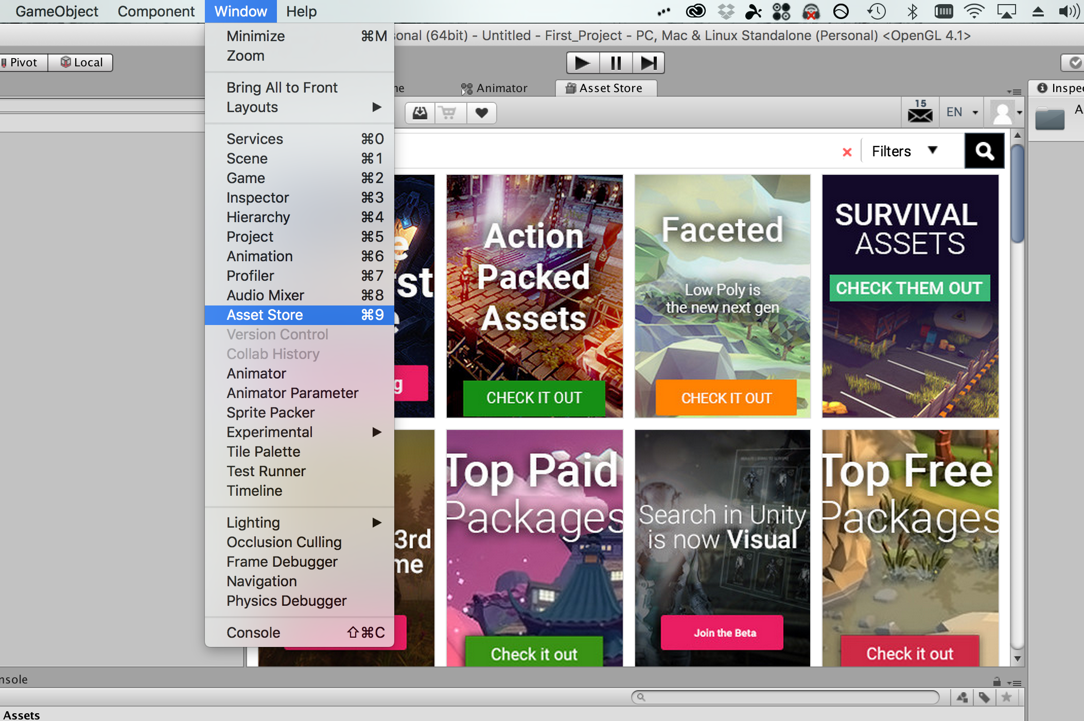
Asset Store

Slide 21
Unity Overview
Not a comprehensive overview

Slide 22
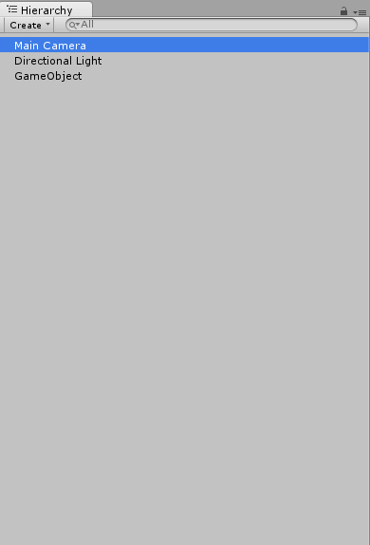
Everything is a “GameObject”
All objects in your scene hierarchy
Cameras
Lights
Gameplay Logic
User Interface
Etc.
Can be destroyed/created on the fly or be made to not get destroyed when the game changes scenes (this is how you get persistent behavior!):
http://docs.unity3d.com/ScriptReference/Object.DontDestroyOnLoad.html

Slide 23
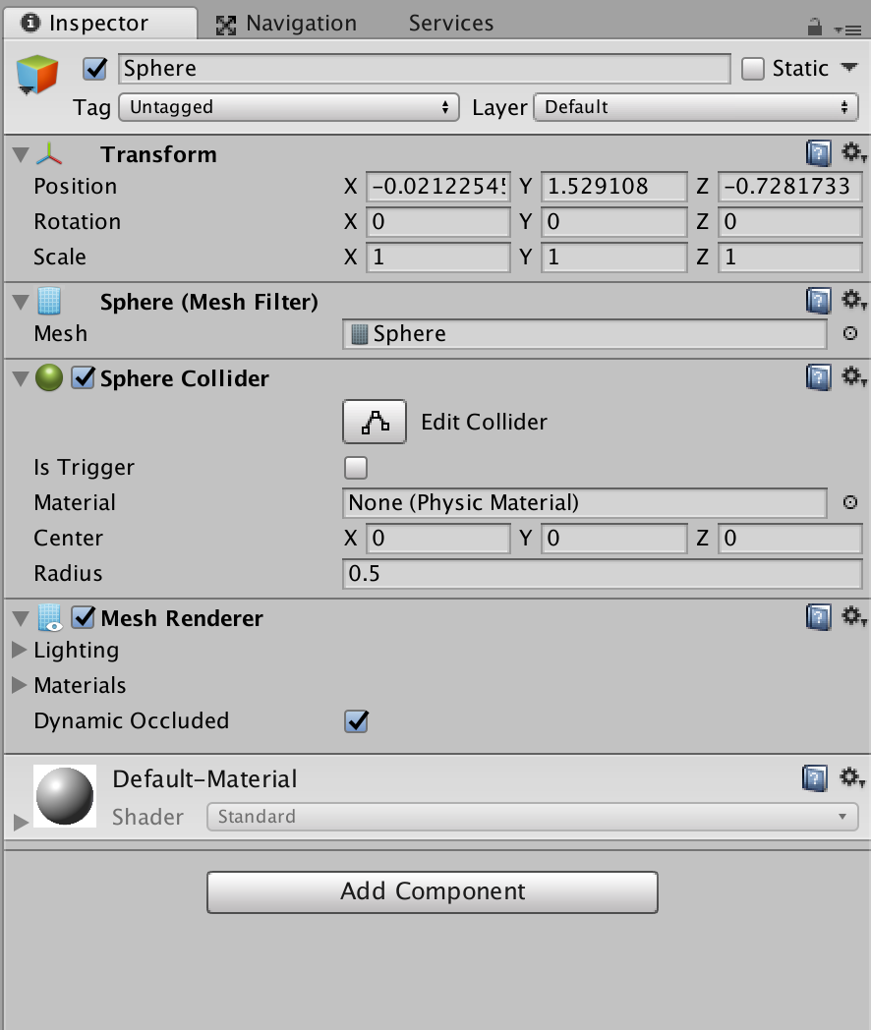
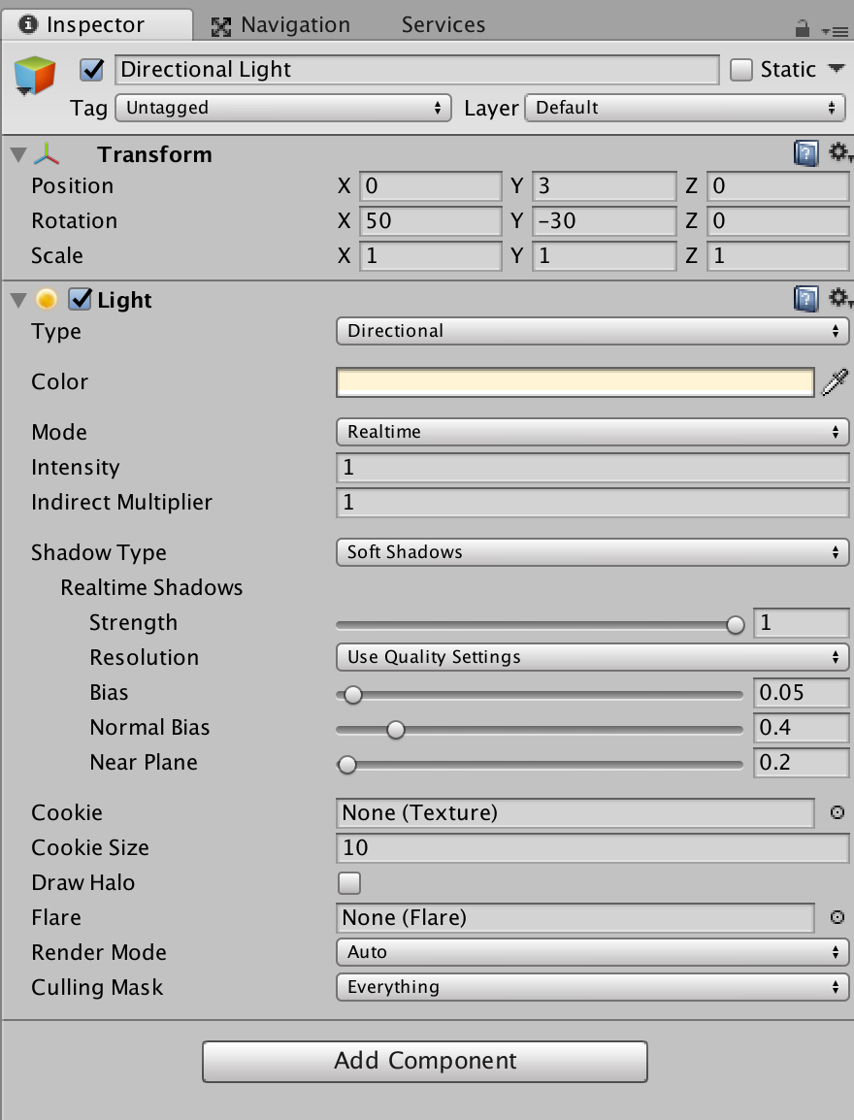
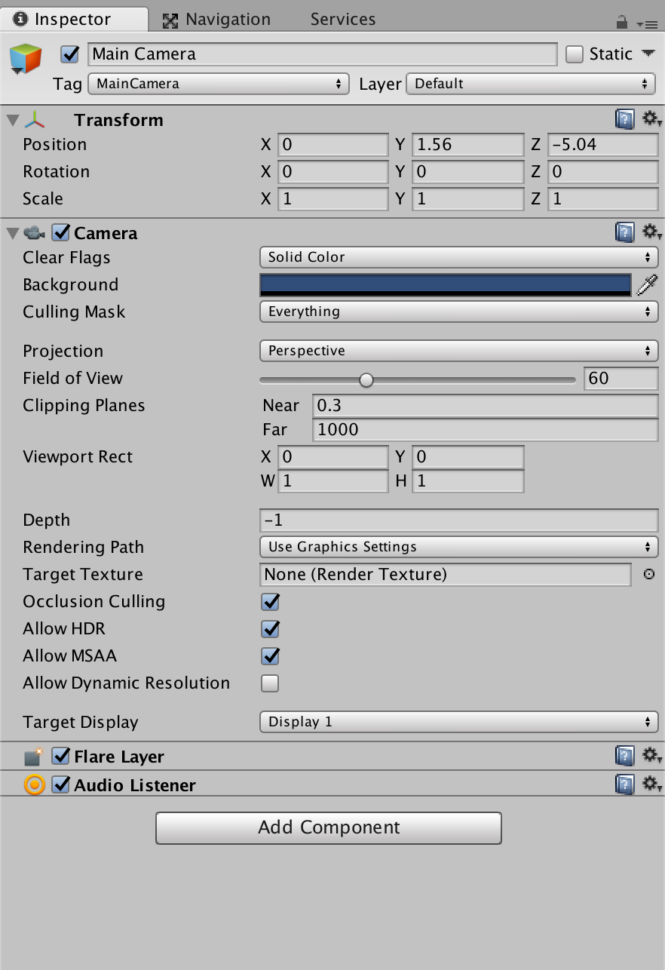
Everything is a “GameObject”
A “GameObject” does nothing on its own.
All “GameObject” have a “Transform” component to let it know its position/rotation/scale.
Must add “Components” to the GameObject to give it some behavior.

Slide 24
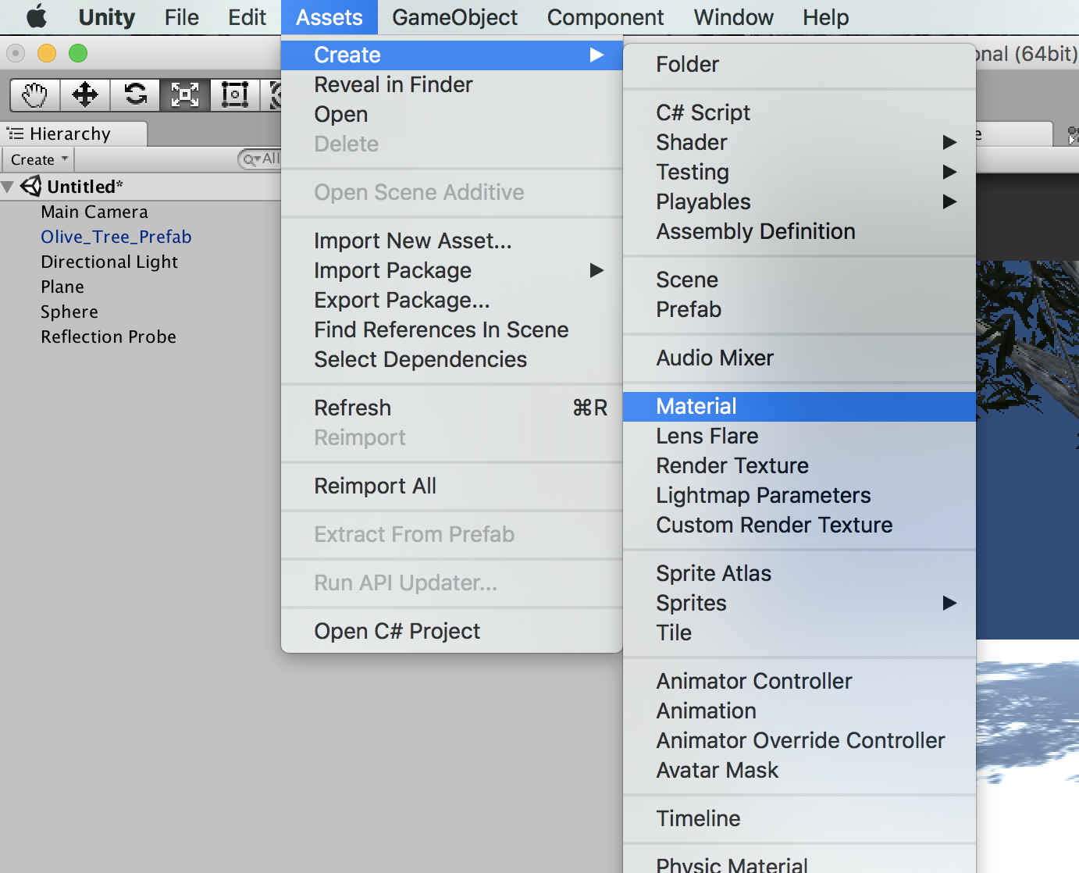
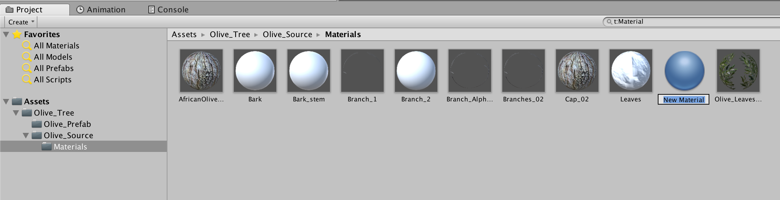
Everything is a “GameObject”
Many components already exist!

Slide 25
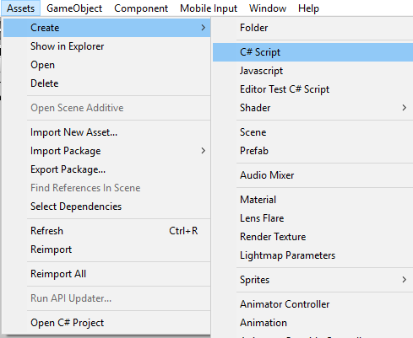
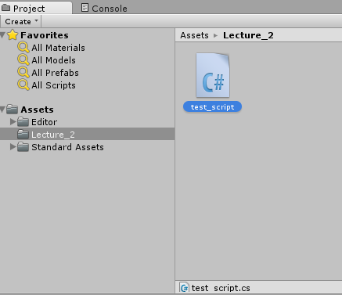
Everything is a “GameObject”
Many components already exist! But you might want to create your own. These are your scripts that inherit from “MonoBehaviour”.
Strong Recommendation: Code in C#.

Slide 26
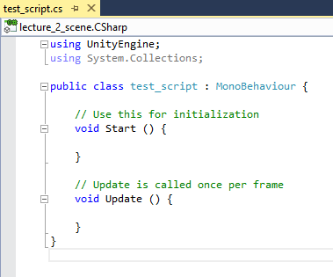
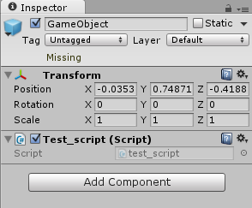
Everything is a “GameObject”
GameObject: http://docs.unity3d.com/ScriptReference/GameObject.html
MonoBehaviour: http://docs.unity3d.com/ScriptReference/MonoBehaviour.html
Drop and Drop Script onto GameObject in the “Inspector” or manually add it by going to Add Component > Scripts > YOUR_SCRIPT_NAME_HERE
Public variables will show up in the Inspector. A variable that is a Component can also be modified by the inspector! Very useful.

Slide 27
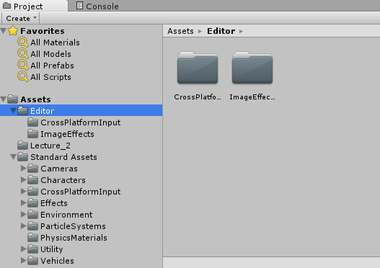
Assets
Scenes
“Prefabs”
Scripts
Textures
Animations
Models
Particles
Sprites
Etc.

Slide 28
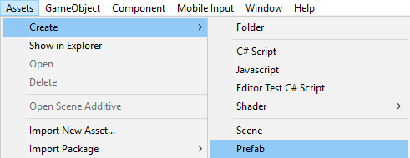
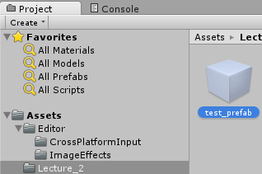
Prefabs
You created some hierarchy of GameObjects and you want to reuse this hierarchy in multiple places. Use prefabs!
You can also assign prefabs to scripts which have a public variable of type “GameObject” to be able to programmatically spawn prefabs! Or you could just load it by its path (may be more convenient in certain cases): http://docs.unity3d.com/ScriptReference/Resources.Load.html
Create an empty prefab and it will go into your assets folder. A gray prefab is an empty prefab!

Slide 29
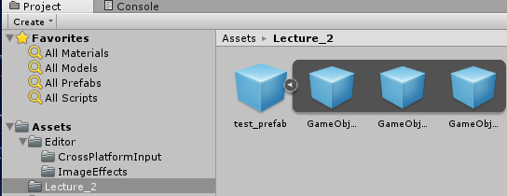
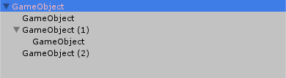
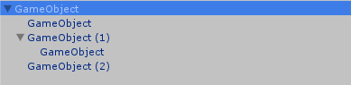
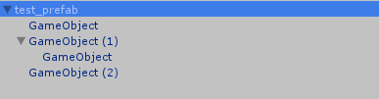
Prefabs
Drag and drop the GameObject onto the gray prefab object and the prefab will turn blue! (and so will the GameObject in the hierarchy). Blue indicates that it is an instance of a prefab and Unity will warn you if you try to change that object!
Now you can delete the GameObject that exists in the hierarchy, drag and drop the prefab back into the hierarchy and you will see the GameObject show up again!

Slide 30
Editor Camera Controls
“Maya”-like Controls:
Alt + Left Click & Move: Rotate Camera
Alt + Right Click & Move (Or Scroll Up/Down): Move camera back and forth
Alt + Middle Click & Move: Move camera up/down or left right
Flythrough Mode:
Click and hold right mouse button and now you can use FPS-like controls to move around through the scene (WASD, Q/E to move up down).
Unity Documentation: http://docs.unity3d.com/Manual/SceneViewNavigation.html

Slide 31
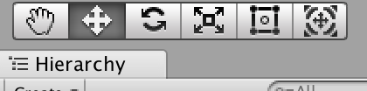
Editor Object Controls
“Maya”-like Controls (after selecting an object):
W: Activate translation widget.
E: Activate rotation widget.
R: Activate scale widget.
Manual Movement:
Modify position/rotation/scale in the Inspector.
Rotation is in Euler angles. Rotation order: Z, X, Y.
Unity Documentation: http://docs.unity3d.com/Manual/PositioningGameObjects.html

Slide 32
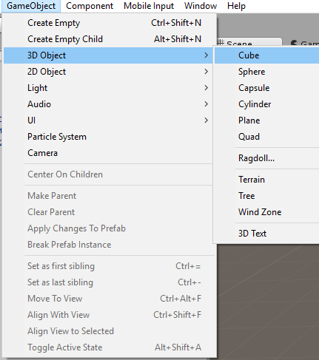
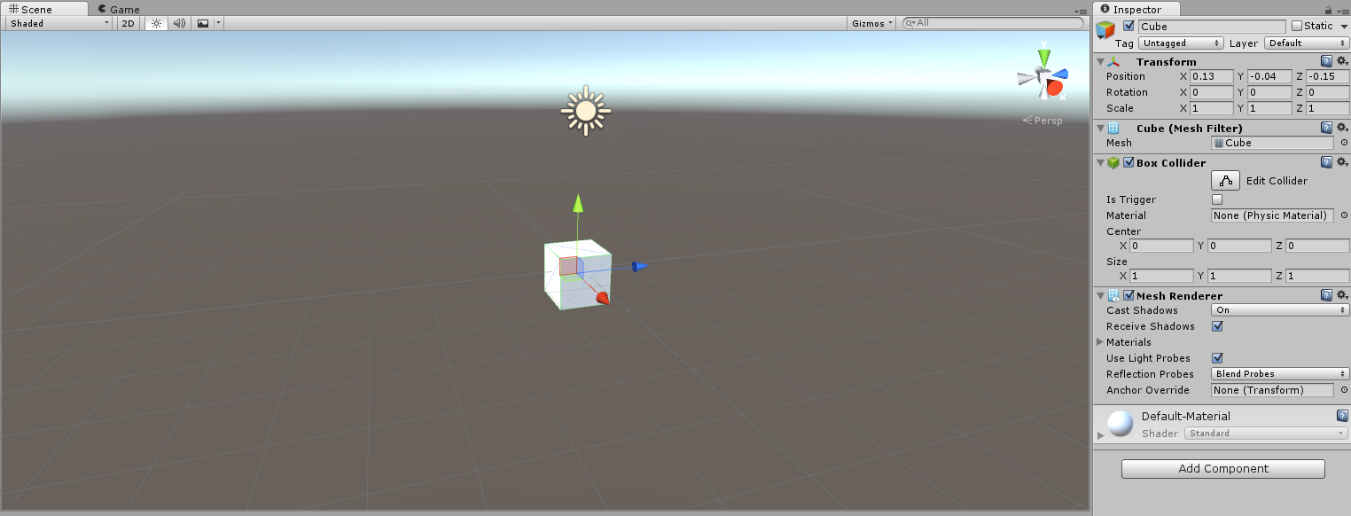
Creating Geometry via the Unity Editor

Slide 33
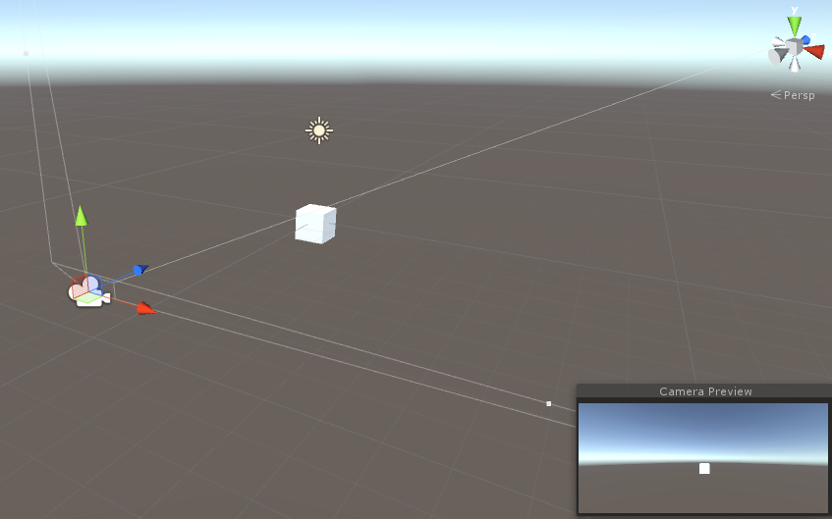
Setting Up The Scene Camera
Do not confuse the scene camera with the editor camera.
Unity scenes by default come with a “Main Camera.” Notice the tag of “MainCamera” in the inspector, this will be useful for accessing the camera from your scripts.
“Camera Preview” box is useful to see what your camera can see.
“Camera Preview” is what you will see when you hit Play!

Slide 34
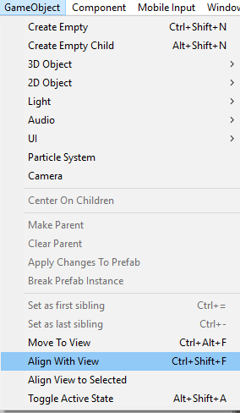
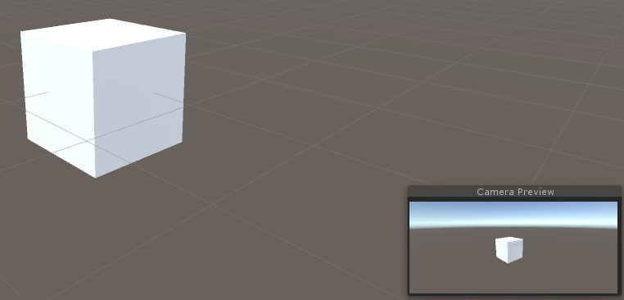
Setting Up The Scene Camera
Moving the scene camera can be done manually by changing the position/rotation/scale in the Inspector.
Or you can move the editor camera around as mentioned earlier, select the camera and align the camera to the view. Note that your camera should be selected before doing this.
Hit play and this view will be sufficient for the screenshot in Assignment 1.

Slide 35
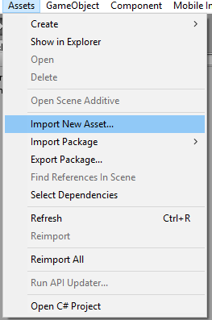
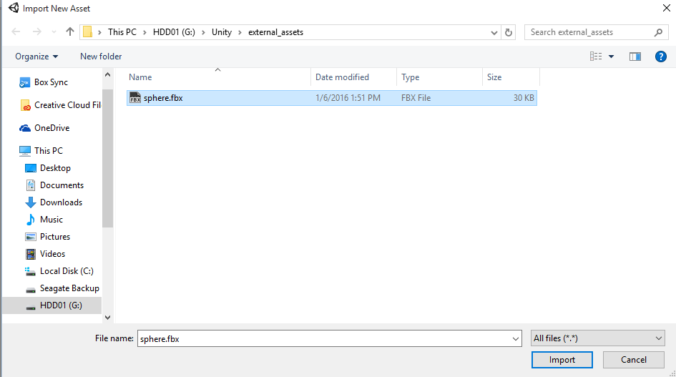
Import External Objects
Create and export an object from Maya/Blender/3ds Max as either an *.OBJ or a *.FBX. You can save this anywhere.
Why *.FBX? You will see later when we start talking about character animation.
Then import this asset into Unity. Unity will take care of everything for you.
Alternatively, you can just save your *.OBJ or *.FBX inside the “Assets” folder.
You will need to right click on the folder it is in and click “Refresh” to get it to show up.

Slide 36
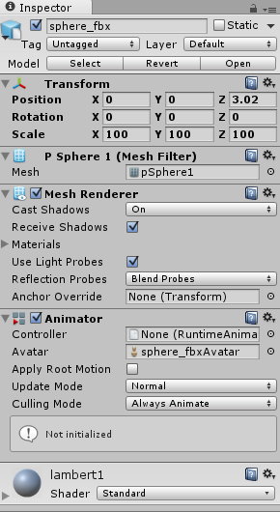
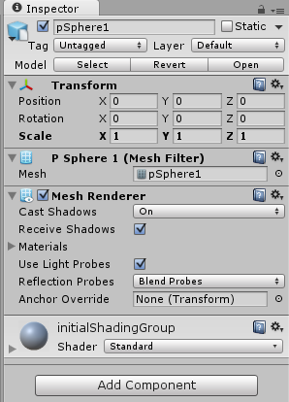
Import External Objects
Click and drag the object from the assets library into your scene hierarchy and it should now show up! There is a difference in how the GameObject is setup depending on whether you use an FBX or OBJ but that difference is not relevant for now.

Slide 37
Shading and Materials
Fairly easy to write your own shader but the Unity Standard shader is very powerful and can probably be used in most situations!
In most cases you will want to select a shader that comes with Unity and modify the material properties to achieve the look that you want
Manual Shader Documentation: http://docs.unity3d.com/Manual/ShadersOverview.html
Standard Shader Documentation: http://docs.unity3d.com/Manual/shader-StandardShader.html
Materials Documentation: http://docs.unity3d.com/Manual/Materials.html

Slide 38
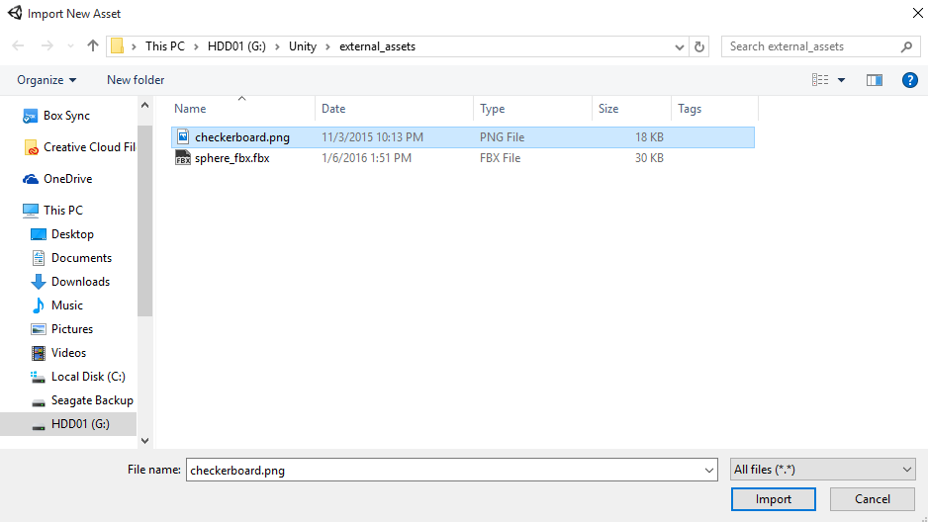
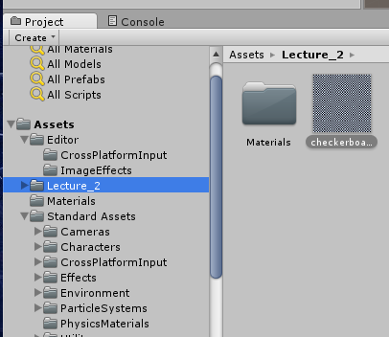
Importing Textures
Process is the same as importing an external object. This time, instead of selecting an *.FBX or *.OBJ, select a *.PNG, *.JPG, etc. You can also place the images inside the Assets folder manually.
Note that you should make sure your imported object has a UV map before continuing! You can check this in Maya/Blender/3ds Max.

Slide 39
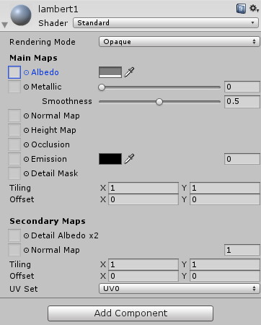
Using Textures
Click on the object you imported in the scene hierarchy and expand the shader properties in the Inspector.
The “diffuse” texture that we used in CS148 is now the “Albedo.” There is no distinction between the diffuse and specular color as you saw with the Epic BRDF.
Look at CS148 Assignment 4 if you want great (no bias) refresher on what the BRDF/Material does.
http://web.stanford.edu/class/cs148/assignments/assignment4.pdf

Slide 40
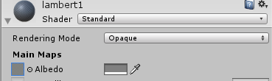
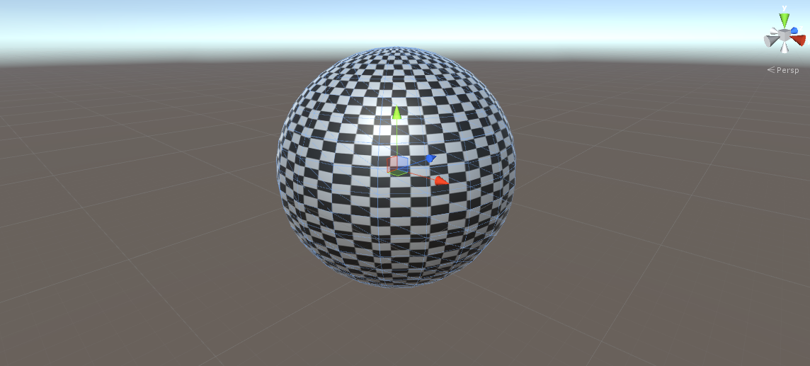
Using Textures (Option 1)
Click and drag the imported texture onto the square next to “Albedo” and your object should now have a texture on it!

Slide 41
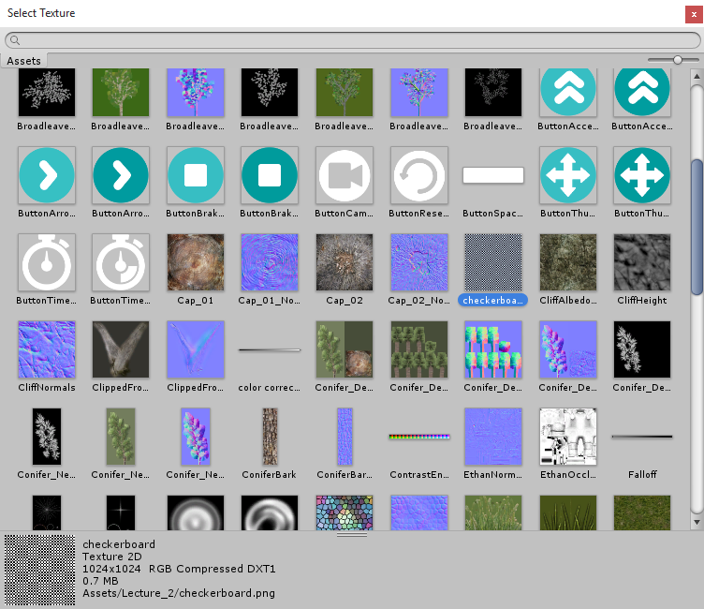
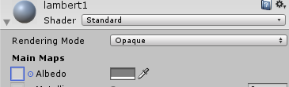
Using Textures (Option 2)
Click on the circle next to Albedo and select your texture in the dialog box!

Slide 42
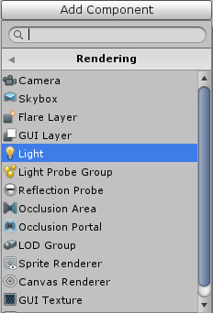
Lighting
Lighting Documentation: http://docs.unity3d.com/Manual/Lighting.html
Global Illumination Documentation: http://docs.unity3d.com/Manual/GlobalIllumination.html
Lighting is accomplished with the “Light” component.

Slide 43
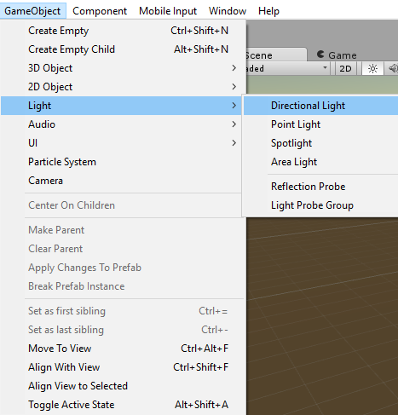
Creating a Light

Slide 44
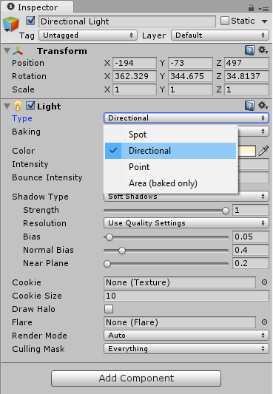
Light Component Properties
Light Types:
Directional Light
Spot Lights
Point Lights
Area Lights

Slide 45
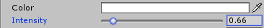
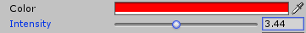
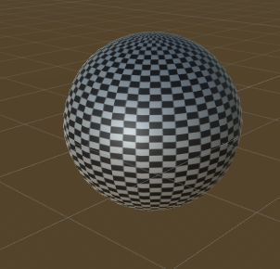
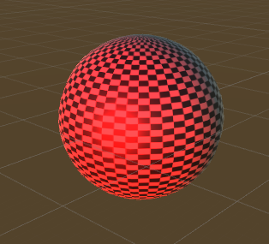
Light Component Properties
Color and Intensity

Slide 46
Unity Tutorial
How to do ASSIGNMENT 1

Slide 47
Questions?
You can also ask me after class.

